Slide 2

Introduction to
Data Science
(IT4142E)

Slide 3
Contents
Lecture 1: Overview of Data Science
Lecture 2: Data crawling and preprocessing
Lecture 3: Data cleaning and integration
Lecture 4: Exploratory data analysis
Lecture 5: Data visualization
Lecture 6: Multivariate data visualization
Lecture 7: Machine learning
Lecture 8: Big data analysis
Lecture 9: Capstone Project guidance
Lecture 10+11: Text, image, graph analysis
Lecture 12: Evaluation of analysis results

Slide 4
Outline
Data integration
Introduction
Current approaches
Apache Nifi
Hand-ons Apache Nifi
Data preprocessing
Introduction
Data quality
Data preprocessing steps
Hand-ons Openrefine

Slide 5
Recall: insight-driven DS methodology
Data collection (scraping)
Data cleaning Data pre-processing
Data integrating
Data exploration
&
visualization
Analysis, hypothesis testing, & ML
Insight & Policy Decision

Slide 6
Data integration
Notes:
Doan, AnHai, Alon Halevy, and Zachary Ives. Principles of data integration. Elsevier, 2012.

Slide 7
Data integration
Provide uniform access to data available in multiple, autonomous, heterogeneous and distributed data sources
Uniform
Access to
Multiple
Autonomous
Heterogeneous
Distributed
Data Sources
Notes:
Provide uniform access to data available in multiple, autonomous, heterogeneous and distributed data sources
Autonomous: tự trị
Uniform (same query interface to all sources)
Access to (queries; eventually updates too)
Multiple (we want many, but 2 is hard too)
Autonomous (DBA doesn’t report to you)
Heterogeneous (data models are different)
Distributed (over LAN, WAN, Internet)
Data Sources (not only databases).

Slide 8
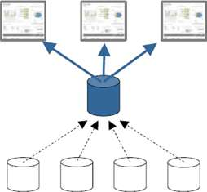
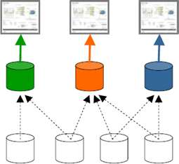
Why data integration
To facilitate information access and reuse through a single information access point
Data from different complementing information systems is to be combined to gain a more comprehensive basis to satisfy the need
Improve decision making
Improve customer experience
Increase competitiveness, Streamline operations
Increase productivity
Predict the future

Slide 9
Data integration challenges
Physical systems
Various hardwares, standards
Distributed deployment
Various data format
Logical structures
Different data models
Different data schemas
Business organization
Data security and privacy
Business rules and requirements
Different administrative zones in the business organization
Notes:
Users will be provided with homogeneous logical view of data physically distributed over heterogeneous data sources
All data has to be represented using the same abstraction principle (unified global data model and unified semantic)

Slide 10
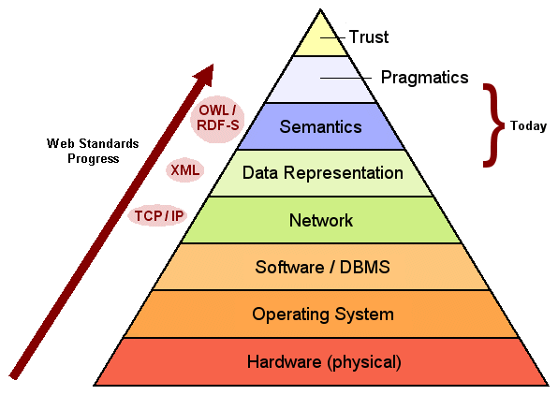
Kinds of Heterogeneity
Hardware and Operating Systems
Data Management Software
Data Models, Schemas and Semantic
Middle-ware
User Interfaces
Business Rules and Integrity Constraints

Slide 11
Current approaches
Data Warehouse
Realize a common data storage approach
Data from several operational sources (OLTP) are extracted, transformed, and loaded (ETL) into a data warehouse
Analysis, such as OLAP, can be performed on cubes of integrated and aggregated data
Query
Data Warehouse
Clean the data
Load Periodically
Data
Sources

Slide 12
Getting data into DW
How to load data into DW?
Scripts in linux shell, perl, python, …
sqlldr + SQL
Hardcoded in Java, C#, C
In-house built ETL tool
Off-the shelf ETL tool
Aspects to be kept in mind
Manageability
Maintainability
Transparency
Scalability
Flexibility
Complexity
Auditing
Job restartability
Testing

Slide 13
ETL process
70-80% of BI (DI or DW) project is reliable ETL process
ETL = Extract – Transform – Load
Extract
Get the data from source system as efficiently as possible
Transform
Perform calculations on data
Load
Load the data in the target storage

Slide 14
Why is ETL (System) Important?
Adds value to data
Removes mistakes and corrects data
Documented measures of confidence in data
Captures the flow of transactional data
Adjusts data from multiple sources to be used together (conforming)
Structures data to be usable by BI tools
Enables subsequent business / analytical data procesing

Slide 15
ETL market

Slide 16
Problems with DW approach
Data has to be cleaned – different formats
Needs to store all the data in all the data sources that will ever be asked for
Expensive due to data cleaning and space requirements
Data needs to be updated periodically
Data sources are autonomous – content can change without notice
Expensive because of the large quantities of data and data cleaning costs

Slide 17
Virtual integration approach
User Queries
Mediated schema
Reformulation engine
Mediator:
Optimizer
Data source
catalog
Execution engine
Wrapper
Wrapper
Wrapper
Data
Source
Data
Source
Data
Source

Slide 18
Virtual integration: Architecture
Leave the data in the data sources
For every query over the mediated schema
Find the data sources that have the data (probably more than one)
Query the data sources
Combine results from different sources if necessary
User Queries
Mediated schema
Mediator:
Reformulation engine
Optimizer
Data source
catalog
Execution engine
Wrapper
Wrapper
Wrapper
Data
Source
Data
Source
Data
Source

Slide 19
Challenges
Designing a single mediated schema
Data sources might have different schemas, and might export data in different formats
Translation of queries over the mediated schema to queries over the source schemas
Query Optimization
No/limited/stale statistics about data sources
Cost model to include network communication cost
Multiple data sources to choose from

Slide 20
Challenges (2)
Query Execution
Network connections unreliable – inputs might stall, close, be delayed, be lost
Query results can be cached – what can be cached?
Query Shipping
Some data sources can execute queries – send them sub-queries
Sources need to describe their query capability and also their cost models (for optimization)
Incomplete data sources
Data at any source might be partial, overlap with others, or even conflict
Do we query all the data sources? Or just a few? How many? In what order?

Slide 21
Wrappers
User Queries
Mediated schema
Mediator:
Reformulation engine
Sources export data in different formats
Wrappers are custom-built programs that transform data from the source native format to something acceptable to the mediator
Optimizer
Data source
catalog
Execution engine
Wrapper
Wrapper
Wrapper
Data
Source
Data
Source
Data
Source
XML
HTML
<book>
<title> Introduction to DB </title>
<author> Phil Bernstein </author>
<author> Eric Newcomer </author>
<publisher> Addison Wesley </publisher>
<year> 1999 </year>
</book>
<b> Introduction to DB </b>
<i> Phil Bernstein </i>
<i> Eric Newcomer </i>
Addison Wesley, 1999

Slide 22
Wrappers(2)
Can be placed either at the source or at the mediator
Maintenance problems
have to change if source interface changes
User Queries
Mediated schema
Mediator:
Reformulation engine
Optimizer
Data source
catalog
Execution engine
Wrapper
Wrapper
Wrapper
Data
Source
Data
Source
Data
Source

Slide 23
Data Source Catalog
Contains meta-information about sources
Logical source contents (books, new cars)
Source capabilities (can answer SQL queries)
Source completeness (has all books)
Physical properties of source and network
Statistics about the data (like in an RDBMS)
Source reliability
Mirror sources
Update frequency
User Queries
Mediated schema
Mediator:
Reformulation engine
Optimizer
Data source
catalog
Execution engine
Wrapper
Wrapper
Wrapper
Data
Source
Data
Source
Data
Source

Slide 24
Schema mediation
Users pose queries over the mediated schema
The data at a source is visible to the mediator is its local schema
Reformulation: Queries over the mediated schema have to be rewritten as queries over the source schemas
How would we do the reformulation?
User Queries
Mediated schema
Mediator:
Reformulation engine
Optimizer
Data source
catalog
Execution engine
Wrapper
Wrapper
Wrapper
Data
Source
Data
Source
Data
Source
Notes:
Luoc do hoa giai

Slide 25
Workflow management approach
Represent an integration-by-application approach
Allow to implement business processes where each single step is executed by a different application or user
Support modeling, execution, and maintenance of processes that are comprised of interactions between applications and human users

Slide 26
Web service approach
Performs integration through software components (web services) that support machine-to-machine interaction by XML-based messages
Depending on offered integration functionality either represent
a uniform data access approach, or
a common data access for later manual or
application-based integration

Slide 27
Apache Nifi
Introduction
What is dataflow?
What is NiFi?
What’s next?

Slide 28
What is dataflow?
Moving some content from A to B
Content could be any bytes
Logs
HTTP
XML
CSV
Images
Video

Slide 29
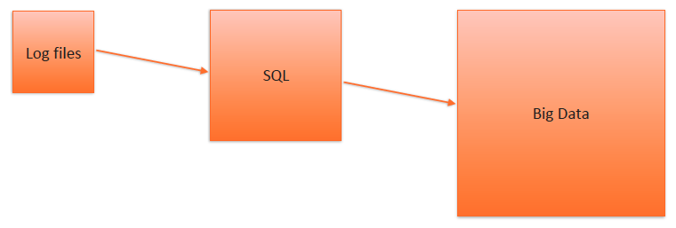
Connecting data points is easy
Simple enough to write a process
Bash/Ruby/Python
SQL proc
etc.

Slide 30
This approach doesn’t scale
Notes:
Example use case:
• AOL Data Processing
• AWS -> HDFS
• 20 TB ingested/day
• Lev Brailovskiy, “Data Ingestion
and Distribution with Apache NiFi”,
Slide 27, 02/2017
• https://www.slideshare.net/
LevBrailovskiy/data-ingestion-anddistribution-
with-apache-nifi

Slide 31
Moving data effectively is hard
Standards: http://xkcd.com/927/

Slide 32
Dataflow challenges in 3 categories
Data
Standards
Formats
Protocols
Veracity
Validity
Schemas
Partitioning/Bundling
Infrastructure
“Exactly Once” Delivery
Ensuring Security
Overcoming Security
Credential Management
Network
People
Compliance
“That [person| team|group]”
Consumers Change
Requirements Change
“Exactly Once” Delivery

Slide 33
NiFi is based on Flow Based Programming (FBP)
FBP term | Niffi Term | Description
Information Packet | FlowFile | Each object moving through the system.
Black Box | FlowFile Processor | Performs the work, doing some combination of data routing, transformation, or mediation between systems.
Bounded Buffer | Connection | The linkage between processors, acting as queues and allowing various processes to interact at differing rates.
Scheduler | Flow Controller | Maintains the knowledge of how processes are connected, and manages the threads and allocations thereof which all processes use.
Subnet | Process Group | A set of processes and their connections, which can receive and send data via ports. A process group allows creation of entirely new component simply by composition of its components.

Slide 34
Nifi key features
Guaranteed delivery
Prioritized queuing
Flow specific QoS
Latency vs. throughput
Loss tolerance
Data provenance
Supports push and pull models
Recovery/recording a rolling log of fine-grained history
Visual command and control
Flow templates
Pluggable, multi-tenant security
Designed for extension
Clustering of Nifi instances

Slide 35
User Interface

Slide 36
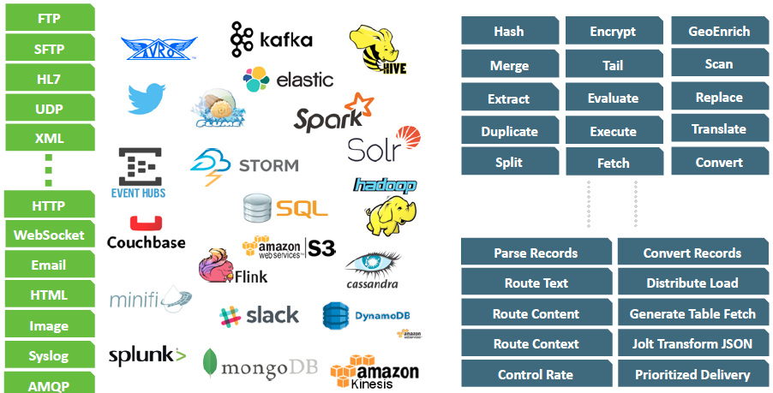
Ecosystem Integration: 260+ Processors, 48 Controller Services

Slide 37
Nifi demonstration

Slide 38
Data cleaning

Slide 39
Why data cleaning?
Data in real world is dirty
Incomplete (e.g name = “”)
Lacking attribute values, lacking certain attributes of interest, or containing only aggregate data
Different considerations between the time when the data was collected and when it is analyzed
Human/hardware/software bugs
Noisy (e.g. salary =‘-10k’)
Containing errors or outliers
Faulty data collection instruments
Human error at data entry
Error in data transmission
Inconsistent (e.g., Age=“20” Birthday=“02/02/2000”)
Different data sources
Functional dependency violation
Duplicate records also need data cleaning

Slide 40
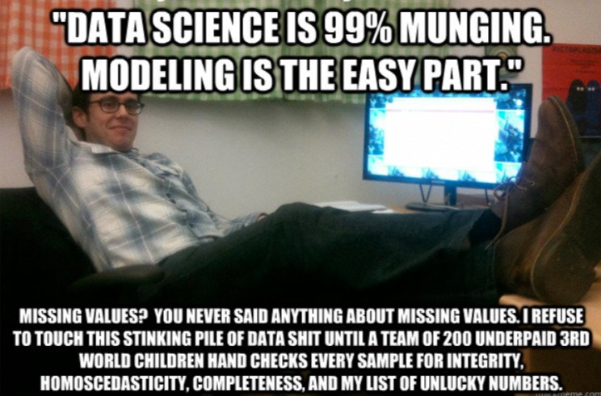
Data preprocessing is costly
Data extraction, cleaning, and transformation comprises the majority of the work of building a data warehouse

Slide 41
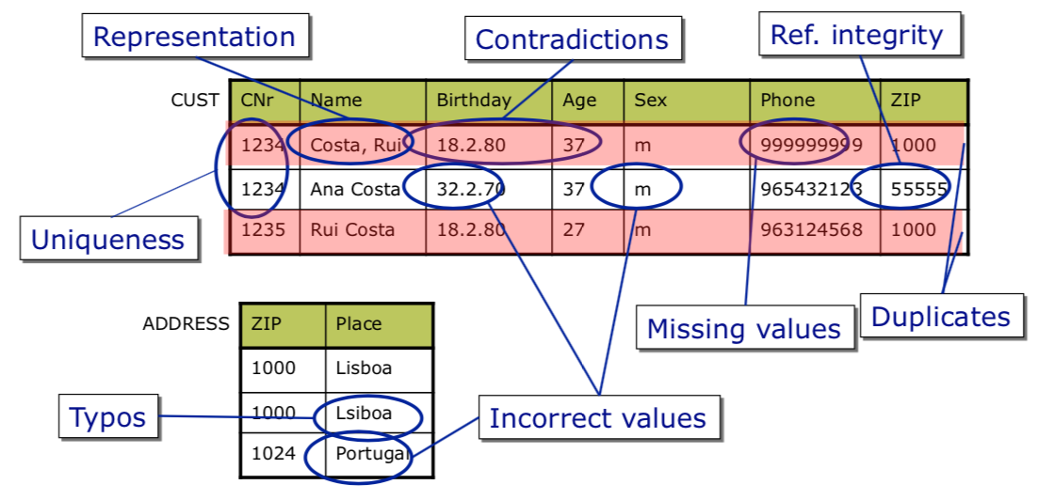
Data quality problems
© fenix.tecnico.ulisboa.pt

Slide 42
No quality data, no quality mining results
Quality decisions must be based on quality data
e.g., duplicate or missing data may cause incorrect or even misleading statistics.

Slide 43
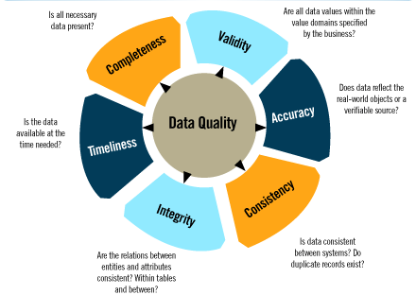
Data quality dimensions
“Even though quality cannot be defined, you know what it is.” Robert Pirsig
Notes:
Accuracy
❑ Refers to the closeness of values in a database to the true values of the entities that the data in the database represent; if it is not 100% that means that there are errors in data
Example:”Jhn” vs. “John”
Completeness
❑ Concerns whether the database has complete information to answer queries
❑ Partial knowledge of the records in a table or of the attributes in a record Currency
❑ Aims at identifying the current values of entities represented by tuples in a database and to answer queries using those values
Example: Residence (Permanent) Address: out-dated vs. up-to-dated
Consistency
❑ Refers to the validity and integrity of data representing real-world entities; if it is violated, leads to discrepancies and conflicts in the data
Example: ZIP Code and City inconsistent

Slide 44
Taxonomy of data quality problems
Value-level
Value-set (attribute/column) level
Record level
Relation level
Multiple relations level

Slide 45
Value level
Missing value: value not filled in a not null attribute
Ex:birthdate=‘’
Syntax violation: value does not satisfy the syntax rule defined for the attribute
Ex:zipcode=27655-175;syntacticalrule:xxxx-xxx
Spelling error
Ex:city=‘Lsboa’,insteadof‘Lisbon’
Domain violation: value does not belong to the valid domain set
Ex:age=240;age:{0,120}

Slide 46
Value-set and record levels
Value-set level
Existence of synonyms: attribute takes different values, but with the same meaning
Ex: emprego = ‘futebolista’; emprego = ‘jogador futebol’
Existence of homonyms: same word used with diff meanings
Ex: same name refers to different authors of a publication
Uniqueness violation: unique attribute takes the same value more than once
Ex: two clients have the same ID number
Integrity contraint violation
Ex: sum of the values of percent attribute is more than 100
Record level
Integrity constraint violation
Ex: total price of a product is different from price plus taxes

Slide 47
Relation level
Heterogeneous data representations: different ways of representing the same real world entity
Ex: name = ‘John Smith’; name = ‘Smith, John’
Functional dependency violation
Ex: (2765-175, ‘Estoril’) and (2765-175, ‘Oeiras’)
Existence of approximate duplicates
Ex: (1, André Fialho, 12634268) and (2, André Pereira Fialho, 12634268)!
Integrity constraint violation
Ex: sum of salaries is superior to the max established

Slide 48
Multiple tables level
Heterogeneous data representations
Ex: one table stores meters, another stores inches
Existence of synonyms
Existence of homonyms
Different granularities: same real world entity represented with diff. granularity levels
Ex: age:{0-30,31-60,>60};age:{0-25,26-40, 40-65, >65}
Referential integrity violation
Existence of approximate duplicates
Integrity constraint violation

Slide 49
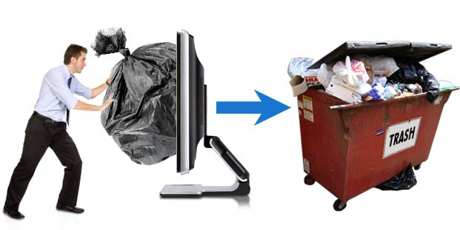
What is data cleaning
Tasks of Data cleaning
Fill in missing values
Value-level problem
Identify / correct noisy data
Value-level or record-level problem
Correct inconsistent data
Record-level problem, attribute-level problem, table-level problem, or multi-table level tables

Slide 50
Manage missing data
Ignore the tuple: usually done when class label is missing (assuming the task is classification—not effective in certain cases)
Fill in the missing value manually: tedious + infeasible?
Use a global constant to fill in the missing value: e.g., “unknown”, a new class?!
Use the attribute mean to fill in the missing value
Use the attribute mean for all samples of the same class to fill in the missing value: smarter
Use the most probable value to fill in the missing value: inference based such as regression, Bayesian formula, decision tree

Slide 51
Manage noisy data
Binning method:
first sort data and partition into (equi-depth) bins
then one can smooth by bin means, smooth by bin median, smooth by bin boundaries, etc.
Clustering:
detect and remove outliers
Regression
Use regression functions
Semi automated
Computer and manual intervention

Slide 52
Manage inconsistent data
Manual correction using external references
Semi-automatic using various tools
To detect violation of known functional dependencies and data constraints
To correct redundant data

Slide 53
Methodology for data cleaning
Extraction of the individual fields that are relevant
Standardization of record fields
Correction of data quality problems at value level
Missing values, syntax violation, etc
Correction of data quality problems at value-set level and record level
Synonyms, homonyms, uniqueness violation, integrity constraint violation, etc
Correction of data quality problems at relation level
Violation of functional dependencies, duplicate elimination, etc
Correction of data quality problems problems at multiple relations level
Referential integrity violation, duplicate elimination, etc
User feedback
To solve instances of data quality problems not addressed by automatic methods
Effectiveness of the data cleaning and transformation process must be always measured for a sample of the data set

Slide 54
Data pre-processing

Slide 55
Data pre-processing
Data smoothing: remove noise from data
Data aggregation: summarization
E.g. Average, median, etc.
Data generalization: concept hierarchy climbing
Data normalization: scaled to fall within a small, specified range
min-max normalization
z-score normalization
normalization by decimal scaling
Data reduction:
Diminish the size of the data
Attribute (feature) engineering
Data wrapping

Slide 56
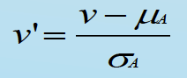
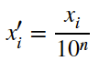
Data normalization
Min-max normalization: transformation maps the values of a variable to a new range [NewMin, NewMax]
Z-score normalization: (μ: mean, σ: standard deviation):
Normalization by decimal scaling: ensures the range is between -1 and 1
with n the number of digits of the maximum absolute value:

Slide 57
Data reduction
Goal: obtain a reduced representation of the data
much smaller in volume yet producing the same (or almost the same) data analysis results
Dimensionality reduction
Feature selection (e.g. genetic algorithm)
Feature extraction (e.g. PCA analysis)
Data Compression
Convert text to numbers
Data clustering
Discretization
Convert continuous data to categories
E.g. age=1 if in [0,12]; 2 if in [12-25], etc…

Slide 58
Technical solutions for data cleaning and pre-processing

Slide 59
Many tools for pre-processing
My personal suggestions (all free)
Open Refine and Trifacta Wrangler are
more user-friendly
With Python libraries, you are more in control
Open Refine
Trifacta Wrangler
Python libraries
Tableau (and its free version Tableau Public)
TabDrake TIBCO
Clarity
Winpure Data
LadderData
Cleaner
Cloudingo
Reifier
IBM Infosphere Quality Stage

Slide 60

Demo on OpenRefine
OpenRefine was formerly Google Refine
It is a desktop application, not a web-service
Your sensitive data is (supposedly) safe
Demo
https://youtu.be/B70J_H_zAWM
More information on
https://guides.library.illinois.edu/openrefine

Slide 61
Practicals using Python libraries
5-days challenge (on the google Teams)
Day 1: Handling missing values
Day 2: Scaling and normalization
Day 3: Parsing dates
Day 4: Character encodings
Day 5: Inconsistent Data Entry
Libraries used:
Pandas
Numpy
Chardet
Datetime
Fuzzywuzzy
Seaborn
Scipy
Mlxtend.preprocessing
Matplotlib.pyplot

Slide 62
Summary
You have learnt about
Decision Support Systems and data warehouses
Data integration
Data cleaning
Data pre-processing
You have had demos / tutorials on
Microsoft SQL Server
Apache Nifi
Openrefine
You will have practicals using Python libraries

Slide 63
Homework
Data integration / pre-processing
Access the demonstration website yourself and learn more about the NIFI flows:
https://youtu.be/MARazprrNYA
Data cleaning
Learn some simple methods to remove outlier data
https://towardsdatascience.com/ways-to-detect-and-remove-the-outliers-404d16608dba
Data pre-processing
Learn more about OpenRefine on
https://guides.library.illinois.edu/openrefine
Practical / programming homework (5-day Challenge)
https://www.kaggle.com/rtatman/data-cleaning-challenge-handling-missing-values

Slide 65

DeepQA: Incremental Progress in Precision and Confidence 6/2007-11/2010
Now Playing in the Winners Cloud
11/2010
4/2010
10/2009
5/2009
Precision
12/2008
8/2008
5/2008
12/2007
Baseline
Notes:
65

Slide 66
Appendix

Slide 67
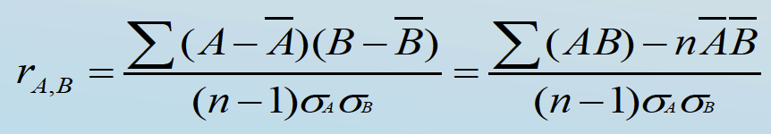
Correlation analysis (numerical data)
Correlation coefficient (also called Pearson’s product moment coefficient)
where n is the number of tuples, and are the respective means of A and B, σA and σB are the respective standard deviation of A and B, and Σ(AB) is the sum of the AB cross-product.
If rA,B > 0, A and B are positively correlated (A’s values increase as B’s). The higher, the stronger correlation.
rA,B = 0: independent;
rA,B < 0: negatively correlated

Slide 68
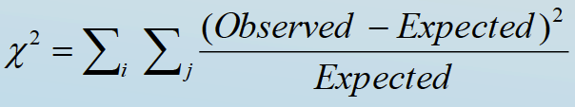
Correlation analysis (categorial data)
Χ2 (chi-square) test
The larger the Χ2 value, the more likely the variables A, B are related (Observed is actual count of event (Ai,Bj))
The cells that contribute the most to the Χ2 value are those whose actual count is very different from the expected count (based on totals)
Correlation does not imply causality
# of hospitals and # of car-theft in a city are correlated
Both are causally linked to the third variable: population

Slide 69
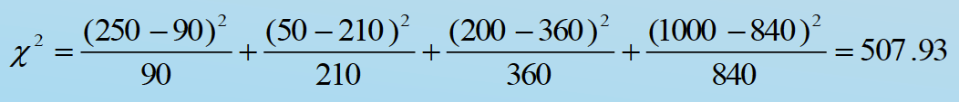
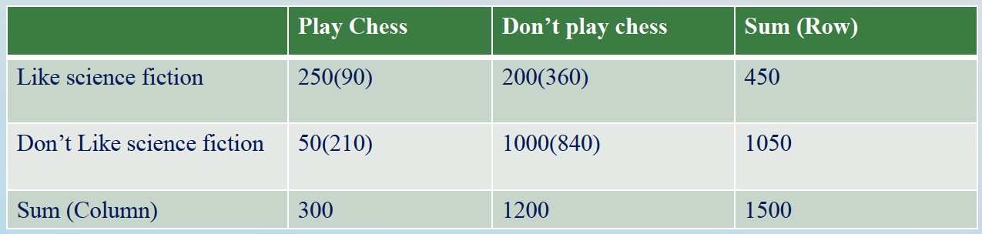
Chi-square calculation: An example
Χ2 (chi-square) calculation (numbers in parenthesis are expected counts calculated based on the data distribution in the two categories)
It shows that like_science_fiction and play_chess are correlated in the group
Notes:
(as 507 > significance level ~10)

